Slide 1
EC521 Cybersecurity Project (Team 1)
Abdulaziz AlMailam, Kwadwo Osafo, Karin Luna

Slide 2
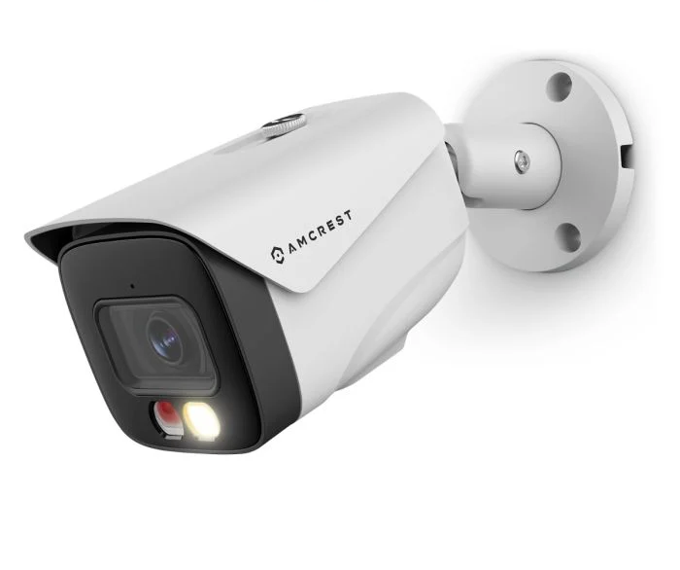
Objective
Evaluate IP Camera security using the Amcrest IP8M-2796EW-AI camera
Cameras are used to secure property – ironically insecure
Raise awareness about the various vulnerabilities within IP cameras
Demonstrate common attacks:
Stack-based buffer overflow
Brute-force login
Denial-of-Service (DoS)
Notes:
Vulnerabilities could include communication vulnerabilities (sniffing packets for user credentials, brute forcing access) and storage vulnerabilities (gaining access to media in storage)

Slide 3
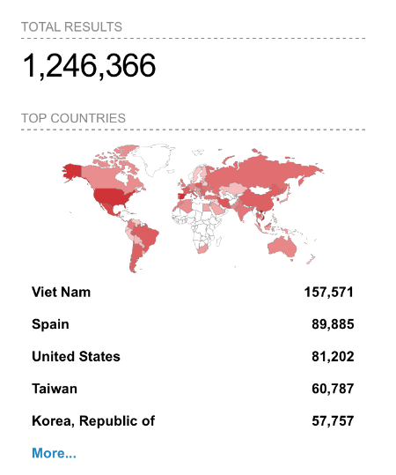
Importance
CCTV is the go-to source for visual evidence (crashed camera = no proof)
Assumption of security & privacy when purchasing a camera
More issues will arise as cameras become more advanced (i.e., Facial Recognition, Smart Alerts)
An attack on one camera likely works on another, too
Dahua & Hikvision manufacture most of the world’s cameras (i.e., Lorex, ICRealtime, Amcrest, Bosch)
Search results for “Dahua” on Shodan
Notes:
Dahua and huawei banned in US yet their devices are still sold in the US under the guise of various child companies

Slide 4
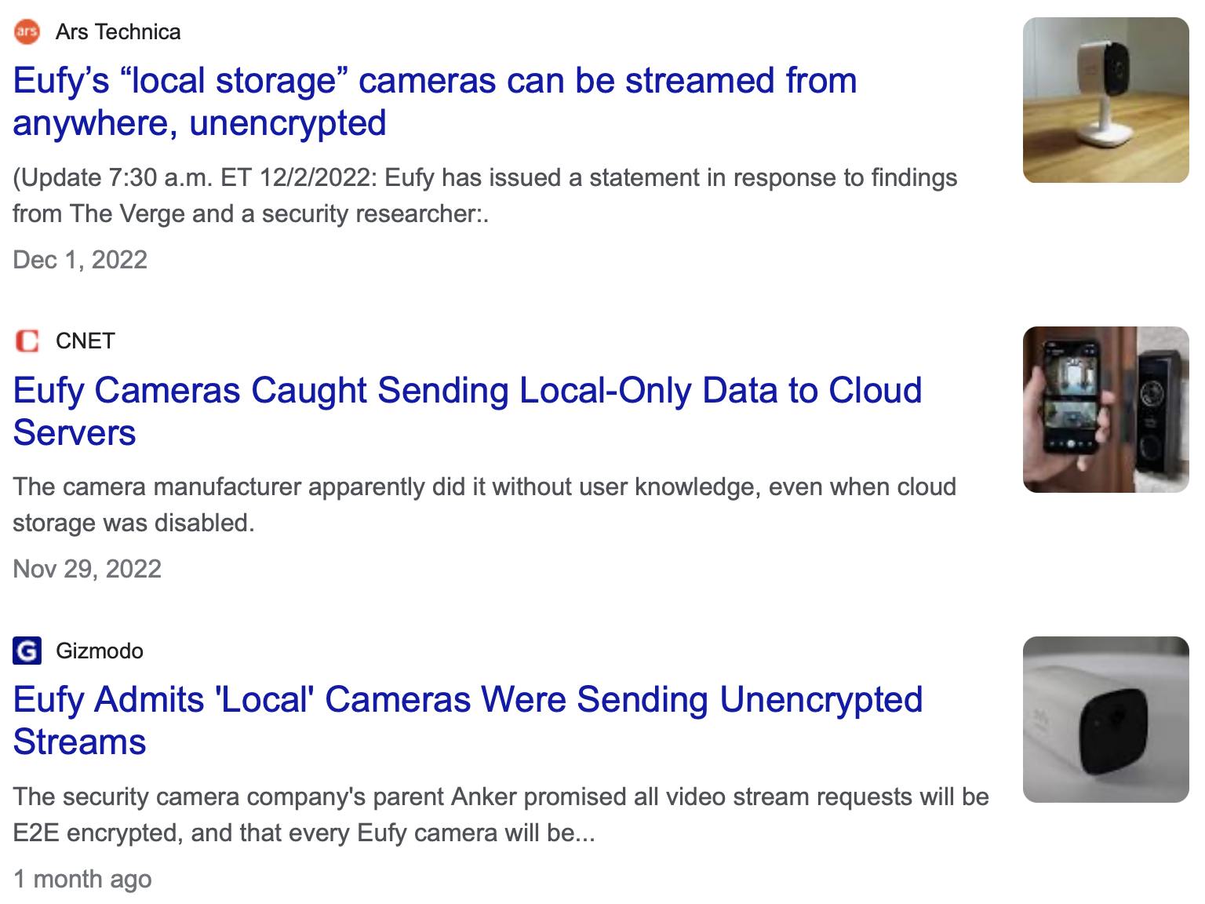

Inspiration
Past breaches and exposed security vulnerabilities
Intrigue on progress made in the industry since
Fictional depictions of it (Ocean’s 8)
Notes:
Big company claimed to store user data locally, but instead used a cloud service unknowing to their users and the feeds could be accessed online unencrypted

Slide 5
Technical Approach
Reconnaissance and application fingerprinting
Packet capture & sniffing, port scanning
Identify exposed endpoints
Review source files
Review previous attacks and known vulnerabilities
Recreate previous attacks on different ports and protocols
Stack-based buffer overflow (i.e., TCP port)
Null pointer reference
Brute-force login script on non-rate-limited ports
Forge authentication handshakes (i.e., ONVIF protocol)
Notes:
Fingerprint the camera to get an idea of how it operates & which ports it’s using, how it’s communicating, etc.
Found a lot of previously verified vulnerabilities with proof of concepts
Stack based buffer overflow and null pointer dereference to crash the device, potentially run arbitrary scripts with the stack buffer overflow. Brute force vulnerability can be used to gain access to users credentials, does not encrypt username in http requests

Slide 6
Technical Approach (continued)
Impersonate storage locations
Fraudulent FTP server, logging authentication credentials (credentials hard-coded at setup)
NAS server, similar approach
Denial of Service (DoS) Attacks
Too many concurrent authentication attempts
Ping flooding, etc.

Slide 7
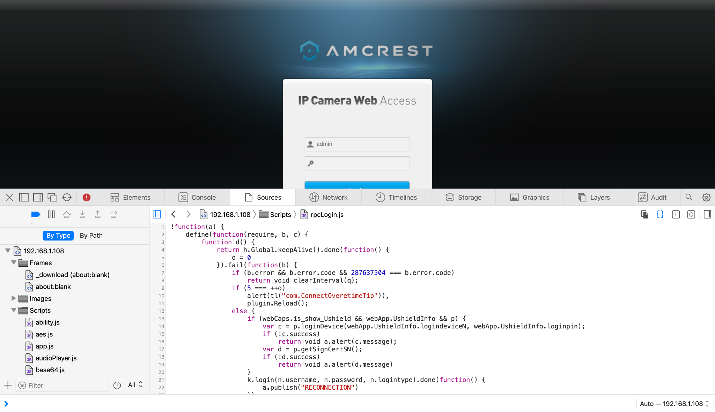
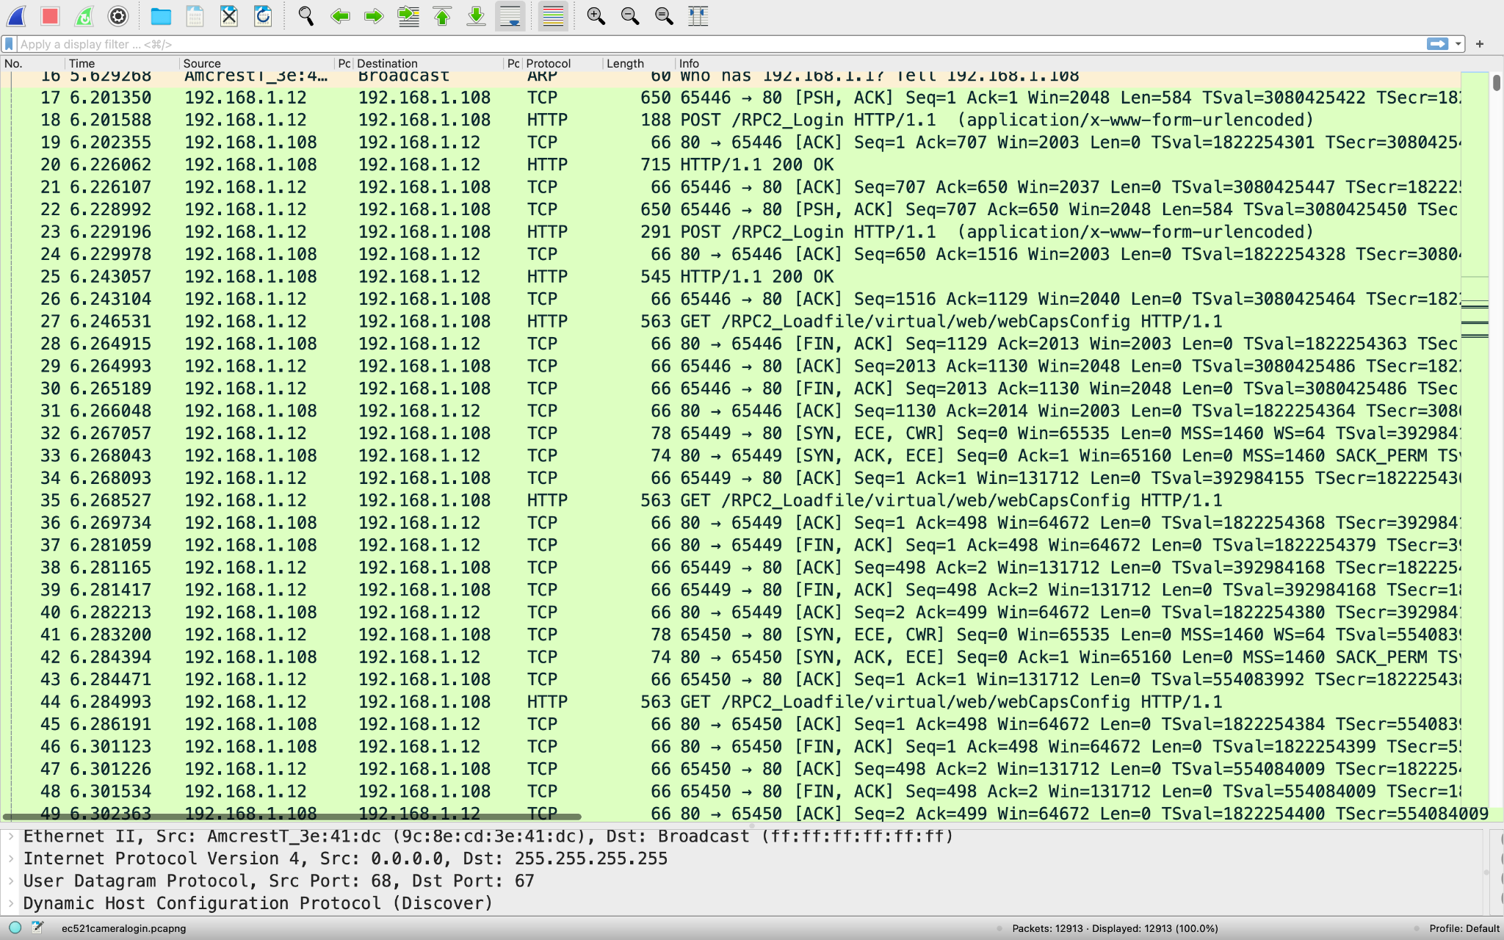
Intermediary Results
Notes:
Access to login script
Viewed http packets from login authentication
Passwords in rpc2 login (solution to previous vulnerability)

Slide 8
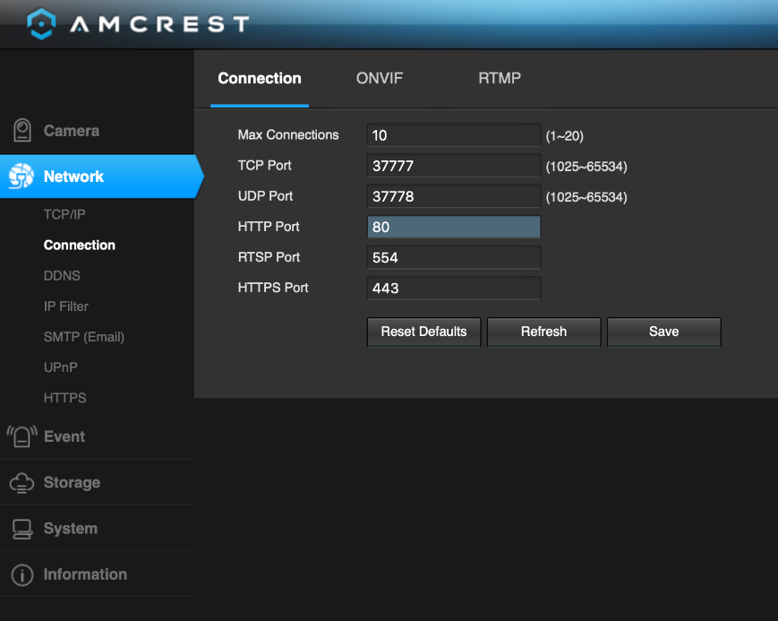
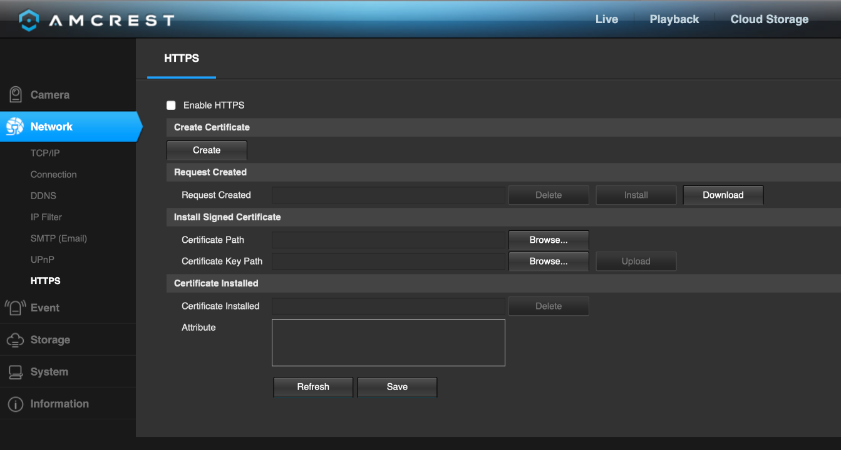
Intermediary Results

Slide 9
Related Results
Vulnerabilities known since first Amcrest/Dahua cameras release
CVE-2020-5735, CVE-2020-5736 – Tenable Proof of Concept (2020)
Eufy Cameras Advertised as ‘Local-Only’ stored data on AWS servers
Note: Updated firmware seems to only be provided on demand, so potentially the majority of devices could still possess these vulnerabilities

